Slide 1
A240
with

Slide 2
Slim.
Style.
Statement.
9.3mm
EXQUISITE DESIGN

Slide 3
SIMPLY BLOW ONTO THE SCREEN OR SHAKE THE HANDSET

Slide 4
5.7 INCH HD IPS SCREEN
PRECISION ENGINEERED SMARTPHONE
SCREEN RESOLUTION: 1280*720 PIXELS
EXCELLENT TOUCH EXPERIENCE

Slide 5
5.0 MP Front Camera
12 MP CAMERA
WITH DUAL LED FLASH
MULTI ZOOM
WIDE SCREEN VIDEO
MULTIPLE PICTURE SETTINGS

Slide 6
1.2GHz QUAD CORE
PROCESSOR
Seamless Multitasking
Blazing Download speed of 42Mbps

Slide 7
Android 4.2.1
JELLY BEAN

Slide 8
ALUMINIUM BATTERY COVER

Slide 9
POWERPACKED
16GB+1GB MEMORY
UP TO 32 GB EXPANDABLE
10GB INTERNAL STORAGE
2600 mAh LI-ION BATTERY
CAPACITIVE STYLUS
FLIPCOVER

Slide 10
SMART FLIP COVERS

Slide 11
Video Pinning
Pin your videos on any screen and surf, text or check mails on your phone at the same time
SMART PAUSE
Video automatically pauses as you look away from the screen

Slide 12
Music Player
New refreshing Music Interfaces

Slide 13
Pop Up Browser
Browser Pinning, browse through the net while working on phone , the browser size can be adjusted

Slide 14
PRELOADED APPS

Slide 15
M! DOODLE
Pre-Loaded Apps
Scribble
Sketch
Draw
Doodle

Slide 16
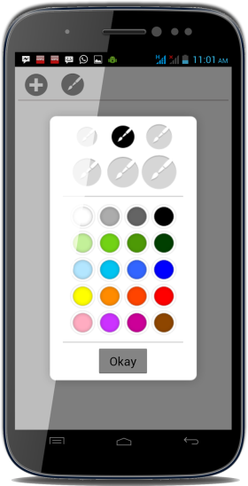
M! DOODLE
Pre-Loaded Apps
Share Pictures, Greetings, Rage faces
and Smileys!
Share Customized web pages & maps
Paint the Canvas in vibrant colors

Slide 17
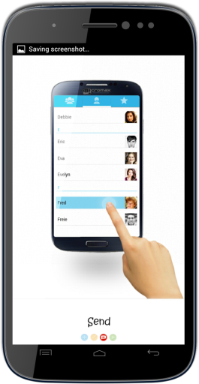
M! DOODLE
Pre-Loaded Apps

Slide 18
EVERNOTE | SKITCH
Pre-Loaded Apps
Remember everything
Customize notes & colors
Share your notes via a public URL
Use annotations, shapes and sketches
Makes it easier to understand
Better communication

Slide 19
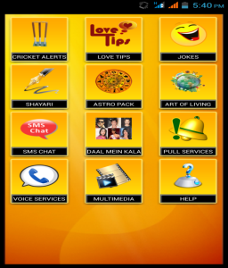
M! Live
HD games, over 5 lakh songs, Wallpapers, Videos & Applications!
Game Hub
Download HD games in both online & offline mode. Games like Need for Speed also preloaded on Canvas 4.
M! Security
Security solutions for all your handset including Backup, Anti-Theft tracker, Anti-Virus & Optimization
M! Zone
A collection of Jokes, Cricket content & much more

Slide 20
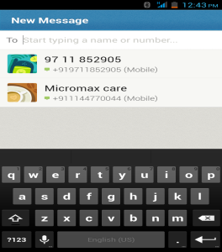
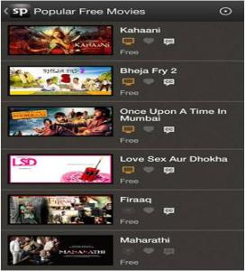
Foneclay
Superb collection of Wallpapers & themes to match your personality
Hike
Chat endlessly without any cost with this app
Spuul
A streaming service for Bollywood Blockbusters & Classic Indian movies & TV shows. Users can sign in via Facebook or Email accounts & watch movies on the go.
KingSoft Office Suite
View & edit your official documents with MS Word, PowerPoint, Excel & PDF docs

Slide 21
Thank You

